Slide 1
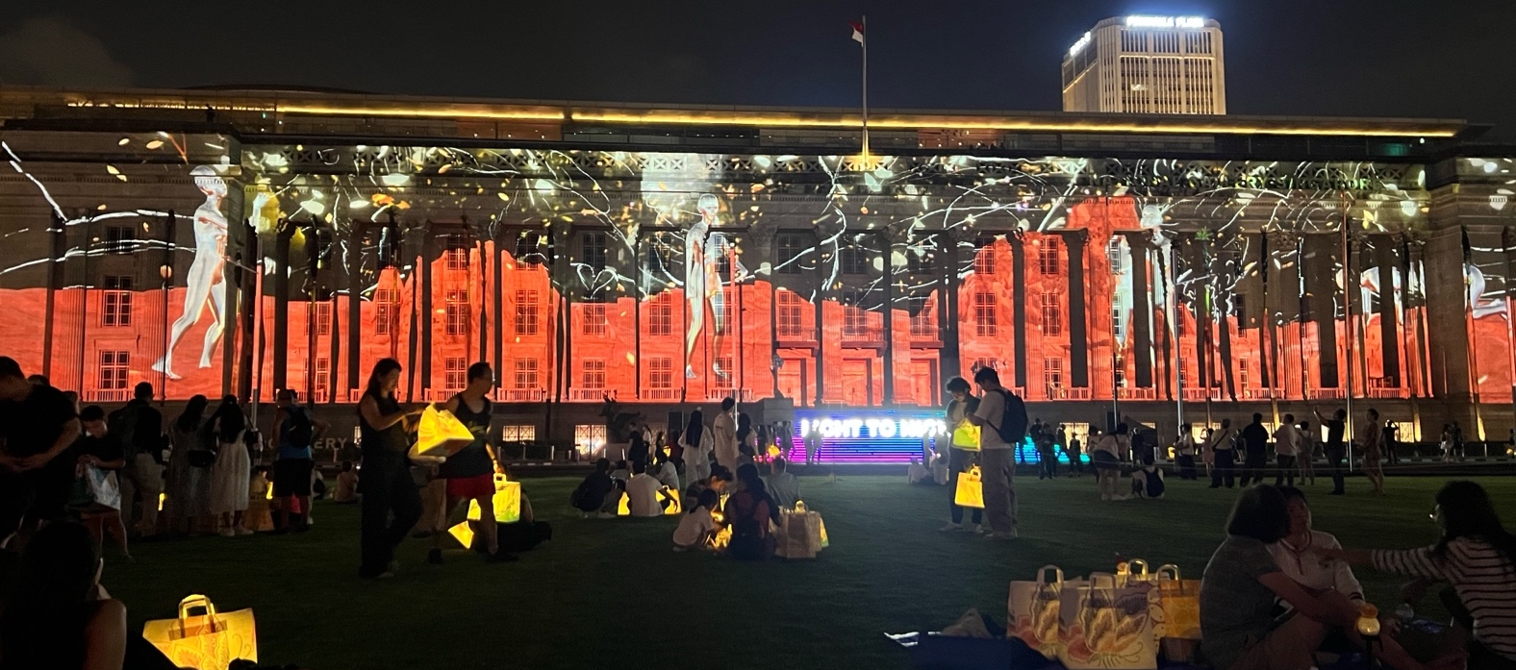
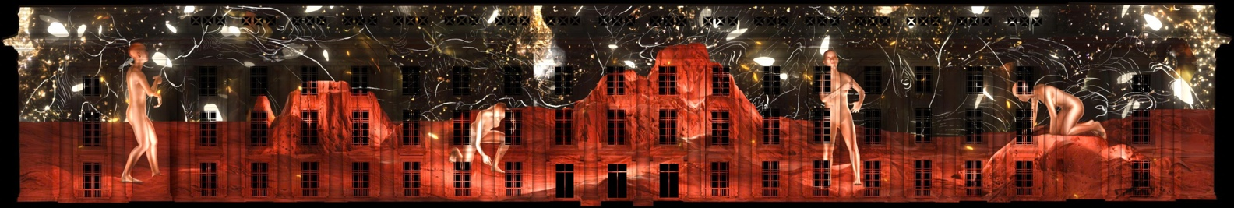
NGOC NAU
01 / 10
Memory Gesture
Two channel video, sound, colour, 3′ · Projection mapping on the façade of the National Gallery Singapore · 2026
Memory Gesture is a three-minute projection mapping work drawn from my experiences with people in my community, including workers in high-tech factories and followers of the Mother Goddess ritual. The work combines 3D animation and projection mapping to reflect on how our worldview has changed over time from a period when humans lived in closer relationship with and respect for nature to a modern world shaped by increasingly rigid and complex structures.

Slide 2
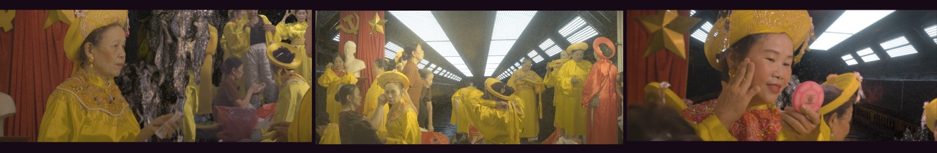
NGOC NAU
02 / 10
All in Good Time
Three channel video, sound, colour, 14′30″ · In collaboration with sound artist Hugo Flores García · 2024
All in Good Time explores the continual transformation of landscape in the technological age, where 3D construction models, local spiritual practices, funerary rituals, visits to sites of natural resource extraction, and the everyday exercise routines of local residents are brought into relation through ongoing shifts between natural and constructed conditions.
This work from Ngọc Nâu examines the datafication of landscape, the planning of everyday life, the intersection of belief systems and technological infrastructures, and the ways in which daily practices are reshaped by extraction and development.

Slide 3
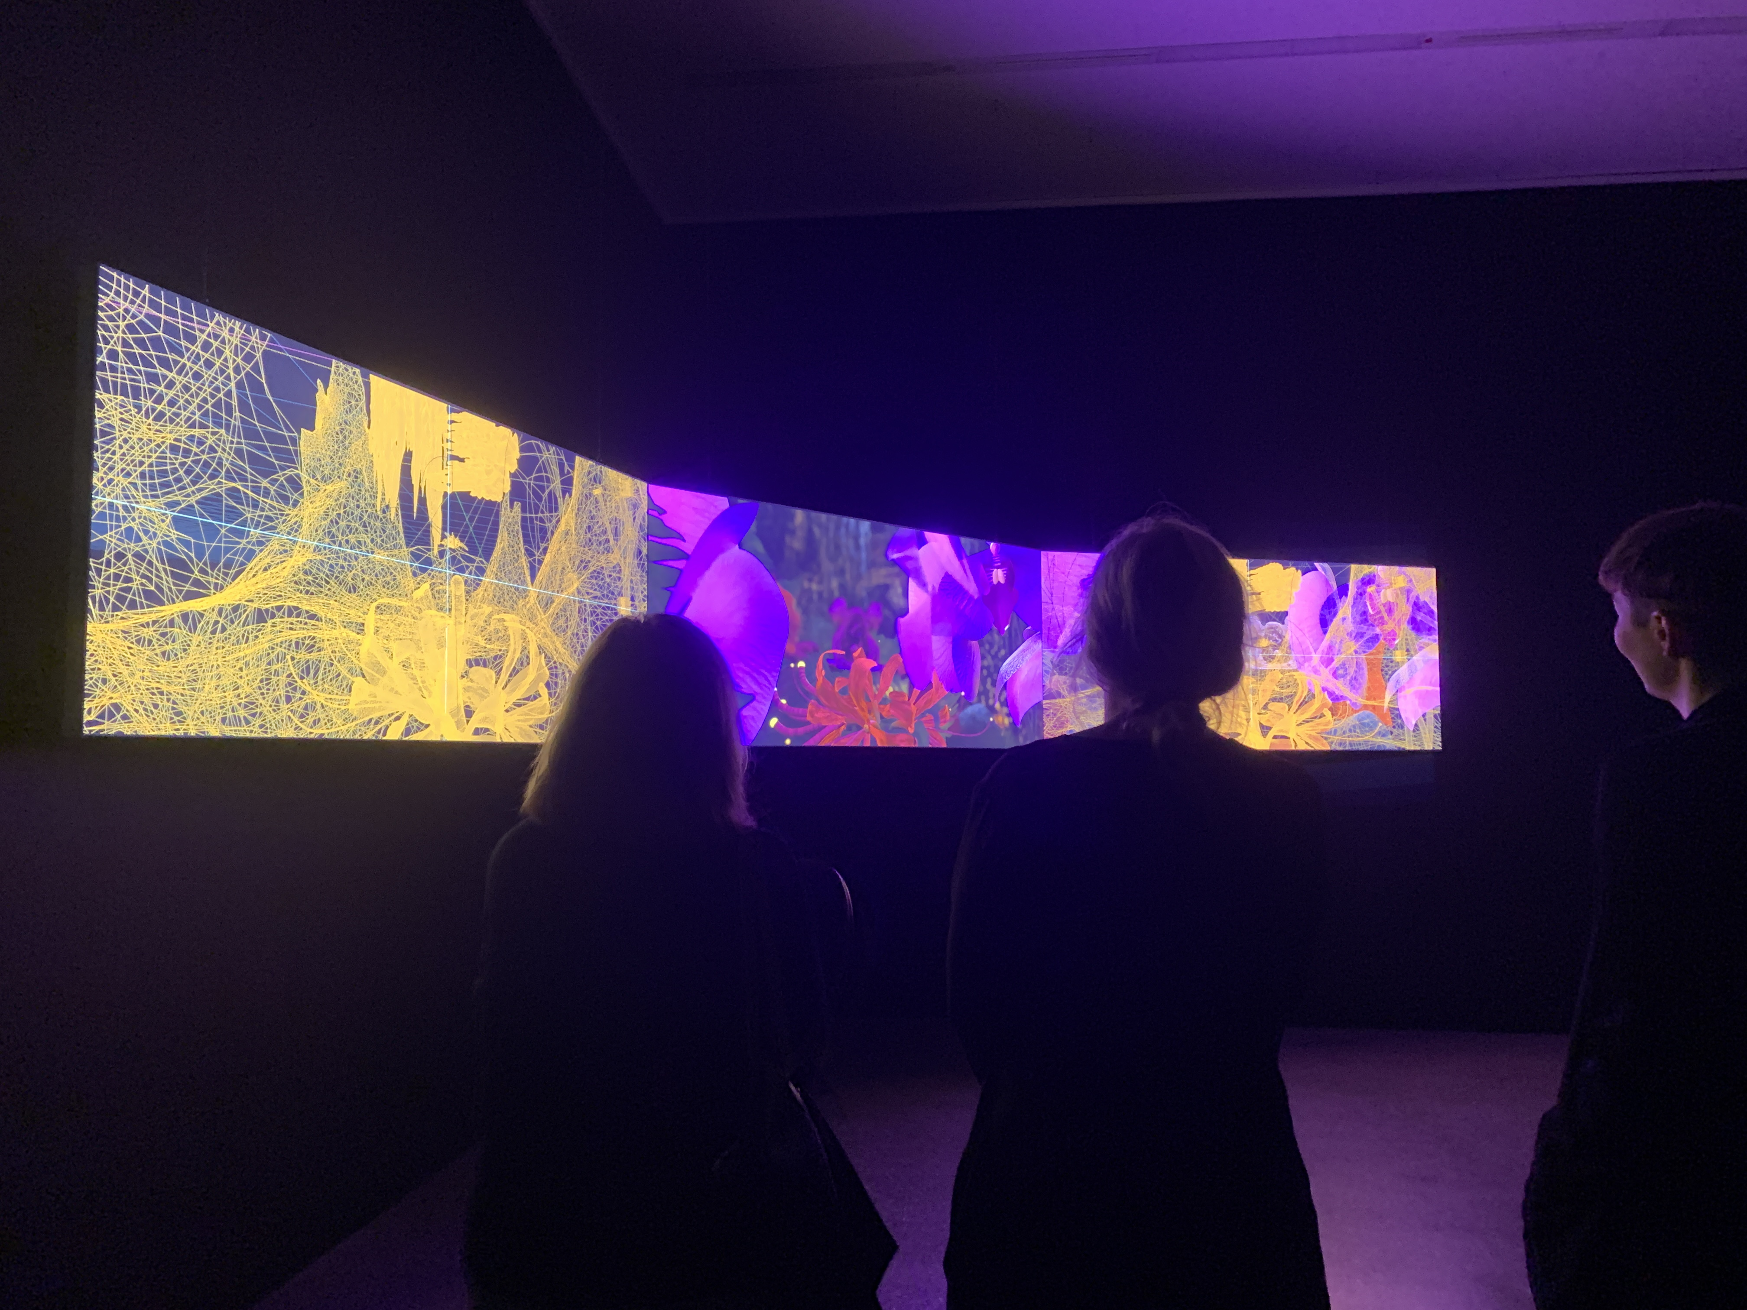
NGOC NAU
02 / 10
All in Good Time
Three channel video, sound, colour, 14′30″ · In collaboration with sound artist Hugo Flores García · 2024
All in Good Time explores the continual transformation of landscape in the technological age, where 3D construction models, local spiritual practices, funerary rituals, visits to sites of natural resource extraction, and the everyday exercise routines of local residents are brought into relation through ongoing shifts between natural and constructed conditions.
This work from Ngọc Nâu examines the datafication of landscape, the planning of everyday life, the intersection of belief systems and technological infrastructures, and the ways in which daily practices are reshaped by extraction and development.

Slide 4
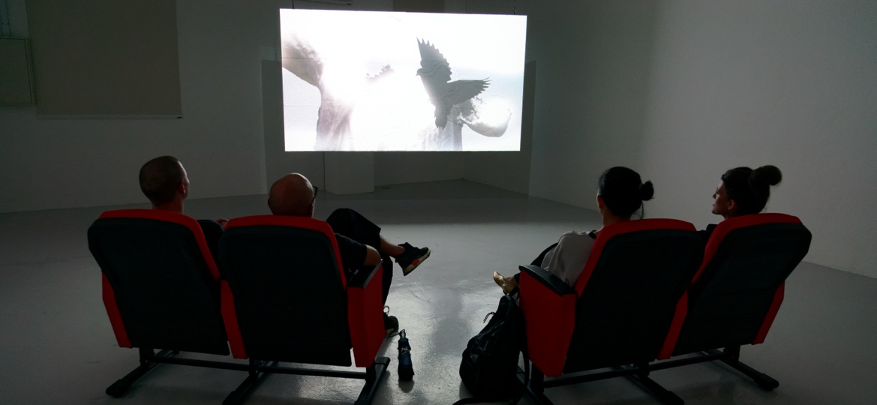
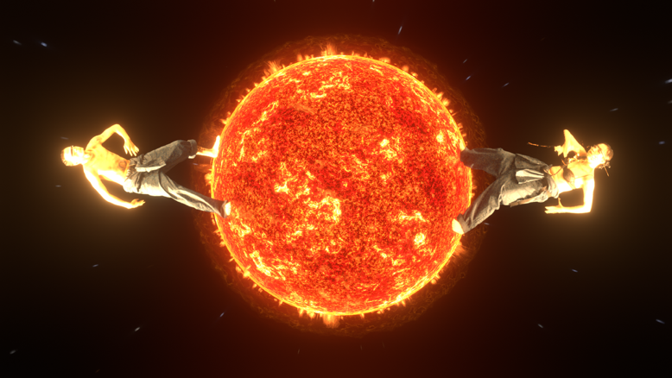
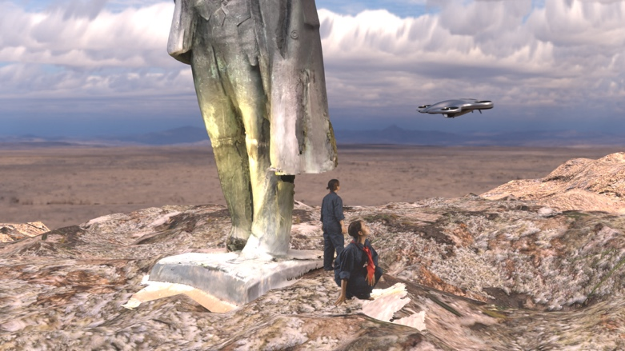
NGOC NAU
03 / 10
Virtual Reverie: Echoes of a Forgotten Utopia
Installation comprising single-channel video, colour, sound, papier-mâché projection screen, metal chains, 6′24″ · Essay “The Lenin Park in Hanoi” by Phuong Phan · 2023
Virtual Reverie: Echoes of a Forgotten Utopia is a video installation exploring contemporary life through the remnants of socialist architecture and monuments. Using CGI, the work reconstructs the Vietnam–Soviet Friendship Palace of Culture and Labour in Hanoi as a stage for five hip-hop dancers, who move between historical memory and the present. It also incorporates a 3D scan of a Lenin statue once erected in Vilnius, Lithuania, whose removal in 1991 symbolised the collapse of socialism and the restoration of independence. Through the dancers’ interactions with these reconstructed sites and objects, the work reflects on how historical ideologies and memories are transformed within contemporary landscapes. The projection is presented on a textured papier-mâché screen inspired by traditional Vietnamese mask-making techniques. The installation is accompanied by an essay, Lenin Park (2023), by Berlin-based Vietnamese researcher and writer Phuong Phan.

Slide 5
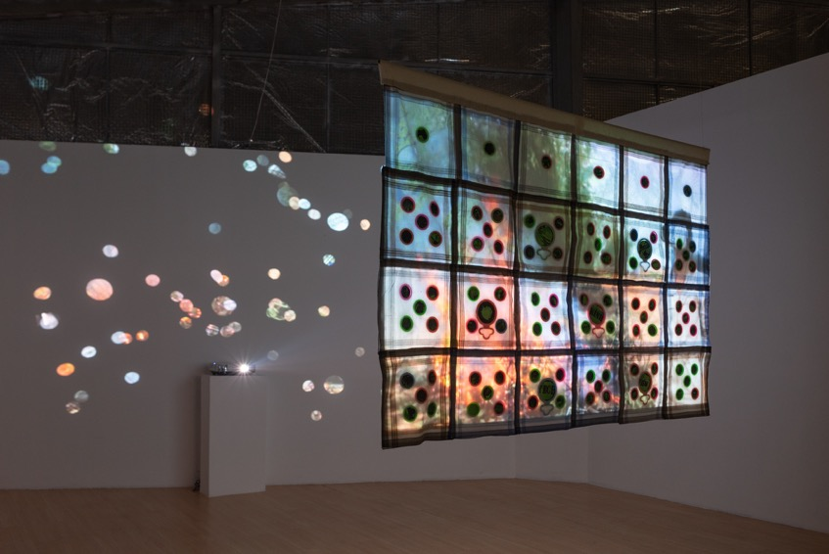
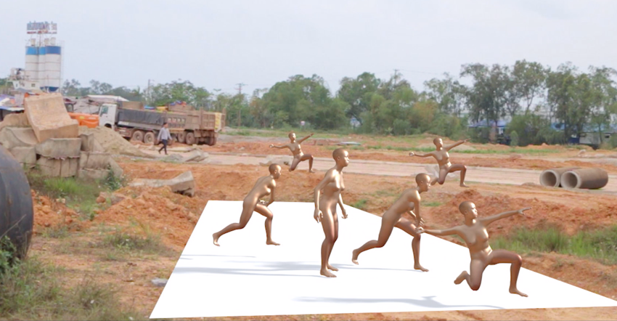
NGOC NAU
04 / 10
Ritual Objects 1
Sculptural single channel video installation · HD, colour, sound; found handkerchiefs, mirror, digital prints on decal · Installed dimensions variable · 2022
This artwork results from the combination of ritual objects, video footages as well as open source content that the artist encountered and gathered through out her creative process. Overall, most of the raw material used for this video comes from public spaces, either physical such as the Hau Dong ritual ceremony, or virtual from social media and digital platform. In 2014, Samsung corporation started to build a factory complex next to the artist’s grandparents’ land in Thai Nguyen. Considered as one of the biggest factories in Southeast Asia, it has modified not only the landscape but also the locals’ living condition. The whole area is under the Vietnamese government’s overall plan to transform the town into one of its centers for technology production.
Meanwhile, in that ever-changing site remain the locals’ reserved sites for ritual practices of Mother Goddess serving their spiritual belief. This tradition has been their form of reminiscing the past as well as expression of hope to be protected by gods. This artwork draws elements from the ceremonies with the intention to present the events that had happened since the presence of Samsung’s intervention through the use of light from reflective material.

Slide 6
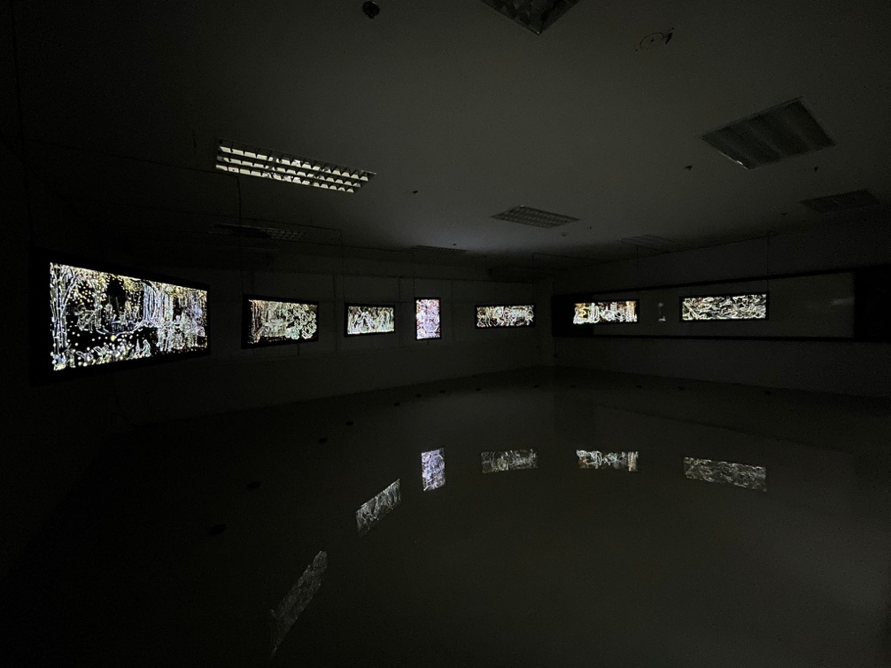
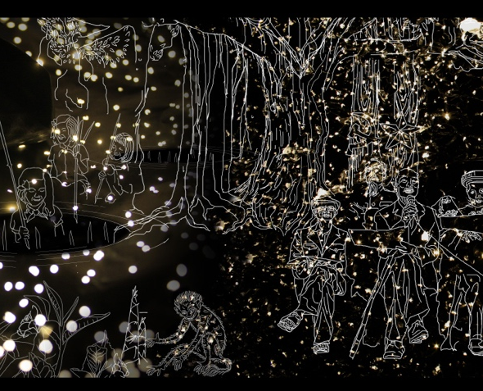
NGOC NAU
05 / 10
The Silent Nights (series of 7)
Photograph printed on acrylic sheet, ironwood · 130 × 50 × 2,8 cm / 6 and 60 × 86 × 2,8 cm / 1 · 2021
The Silent Nights is a series of 7 photograph lightboxes inspired by stories of the artist’s mother. It is about people’s life in the ’60s, after evacuating from Hanoi capital to Thai Nguyen province when the US invaded the North. Those stories depict the way people integrated the nature, and how they transformed and absorbed it for survival needs. The story of an individual as well as the story of a collective. Ngoc Nau’s work constantly jumps from past to present.

Slide 7
NGOC NAU
05 / 10
The Silent Nights (series of 7)
Photograph printed on acrylic sheet, ironwood · 130 × 50 × 2,8 cm / 6 and 60 × 86 × 2,8 cm / 1 · 2021
The Silent Nights is a series of 7 photograph lightboxes inspired by stories of the artist’s mother. It is about people’s life in the ’60s, after evacuating from Hanoi capital to Thai Nguyen province when the US invaded the North. Those stories depict the way people integrated the nature, and how they transformed and absorbed it for survival needs. The story of an individual as well as the story of a collective. Ngoc Nau’s work constantly jumps from past to present.

Slide 8
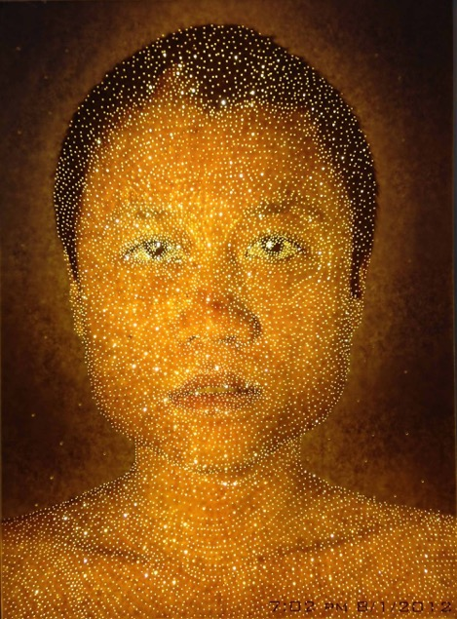
NGOC NAU
05 / 10
Light Portrait
Photograph printed on paper, led light, wood · 50 x 70 x 5cm · 2013

Slide 9
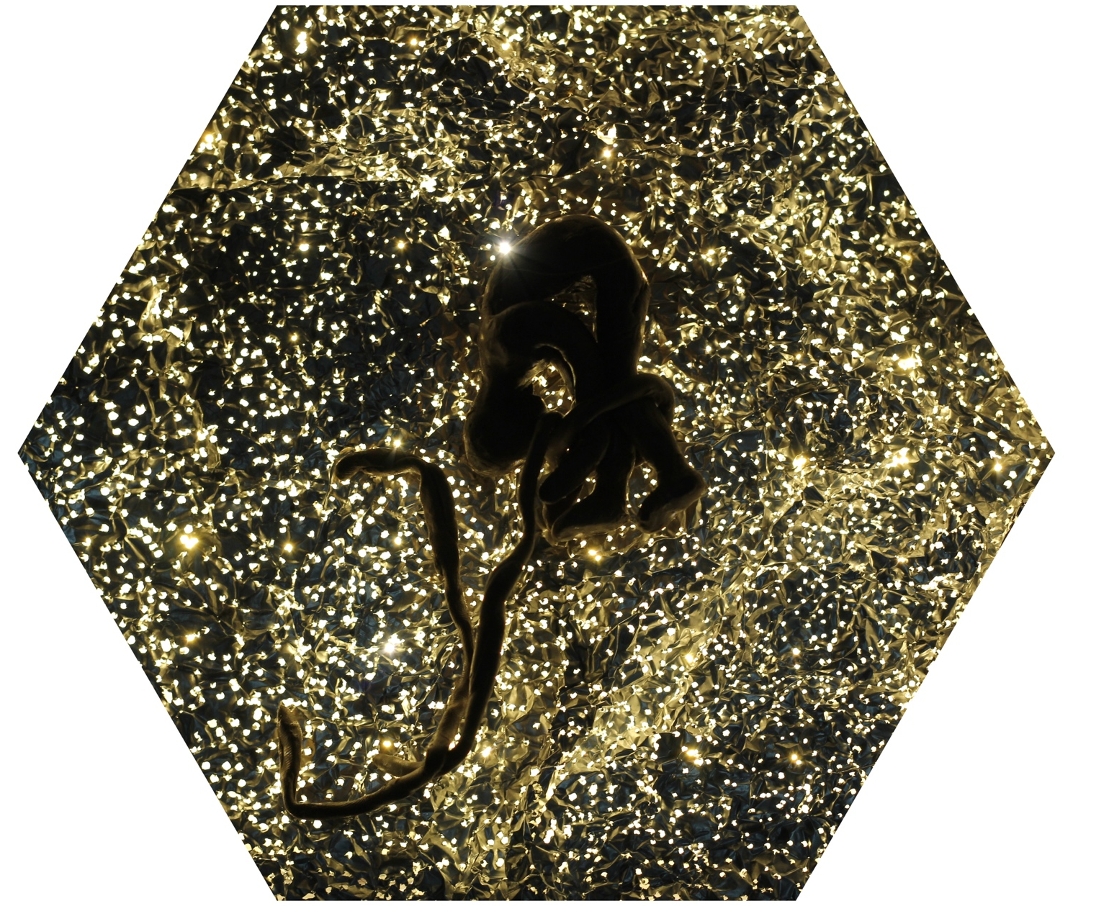
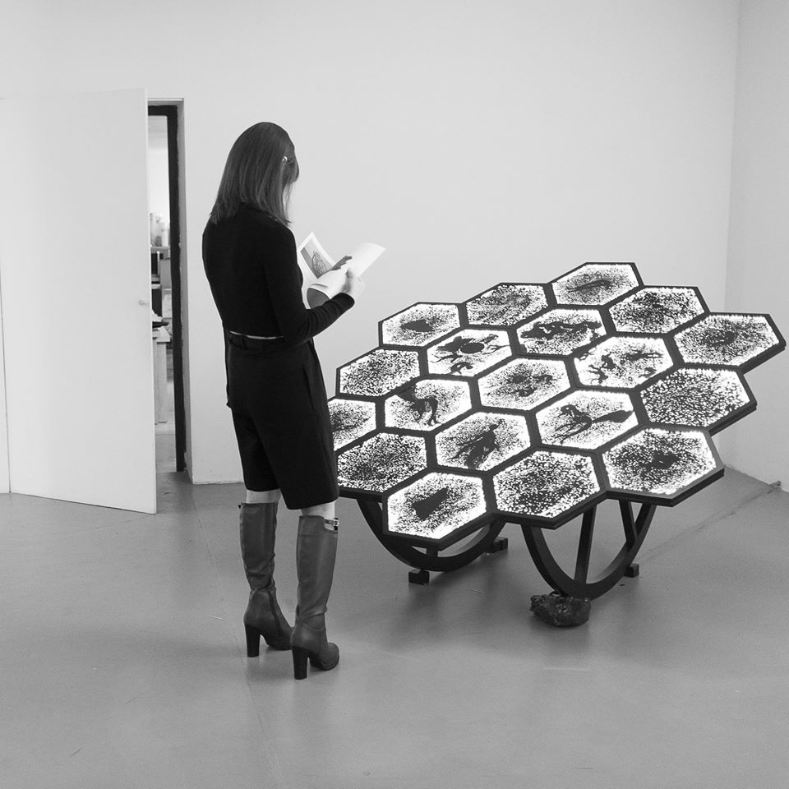
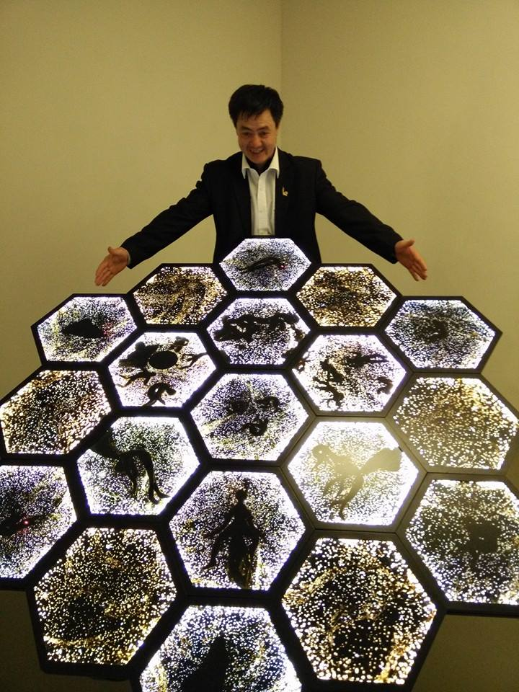
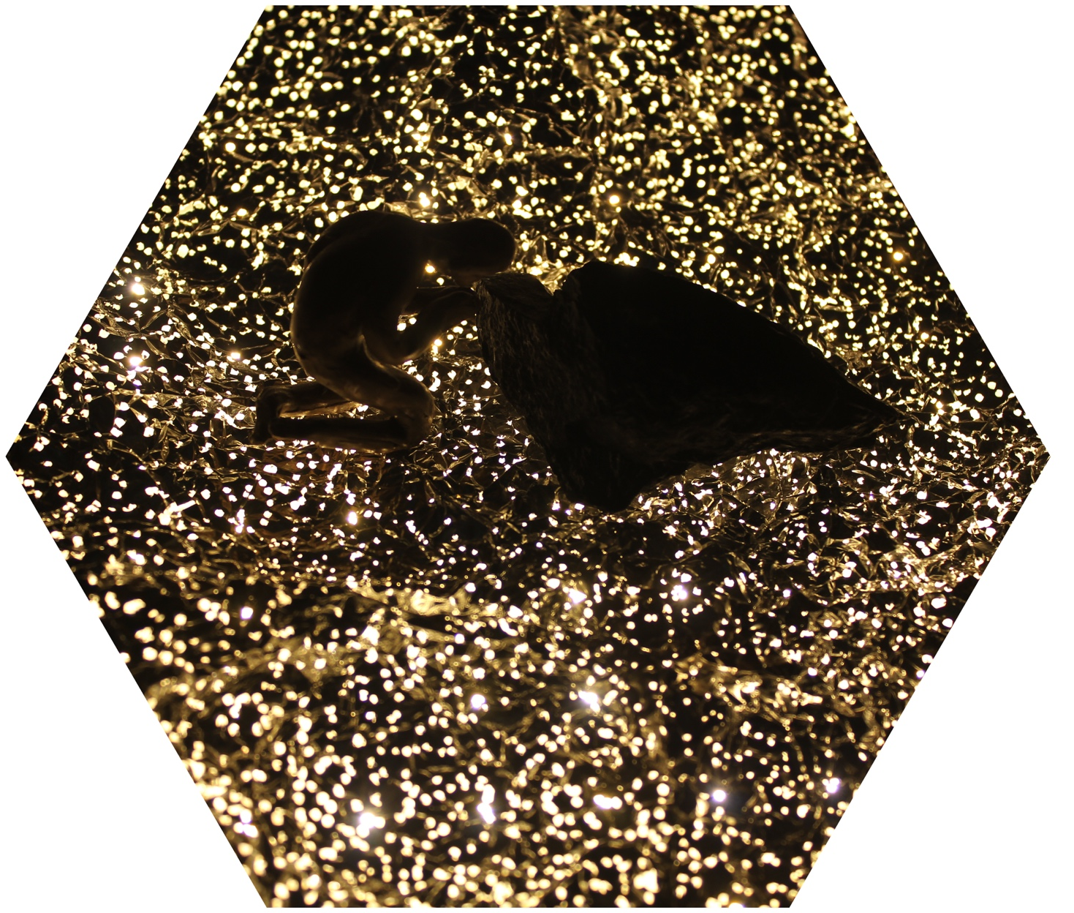
NGOC NAU
05 / 10
F.F.C.C
Photograph printed on acrylic sheet, ironwood · 150cm x 150cm x 100cm · 2015

Slide 10
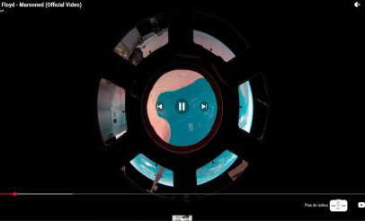
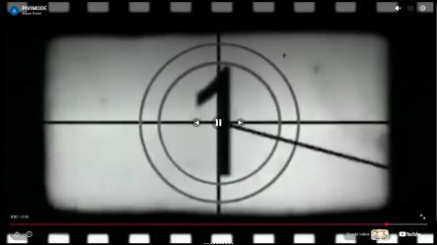
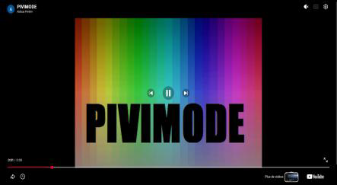
VINCENT PITON · CURRENT RESEARCH
06 / 10
Pivitim
2016 · Interactive web project · Independent development, several months · www.pivitim.com
Pivitim is a digital oracle built around a deliberately simple mechanism: randomness. Each time somebody enters the website, the system independently selects a video and a sound from two separate collections and plays them simultaneously there is no intentional relationship between them.
Yet viewers may perceive correspondences: a movement appears synchronized with a sound, an atmosphere seems unexpectedly coherent, two unrelated events suddenly appear to belong together.
Pivitim does not predict anything and does not assign meaning to these combinations; instead, it creates the conditions in which participants can observe their own tendency to identify patterns and construct meaning from unrelated stimuli. Every visit generates a temporary and unique audiovisual environment.
“Developed in 2016 as my first software project, Pivitim initiated questions that continue throughout my work today: randomness, synchronicity, projection, and the uncertain boundary between relationships produced by a system and meaning produced by its observer.”

Slide 11
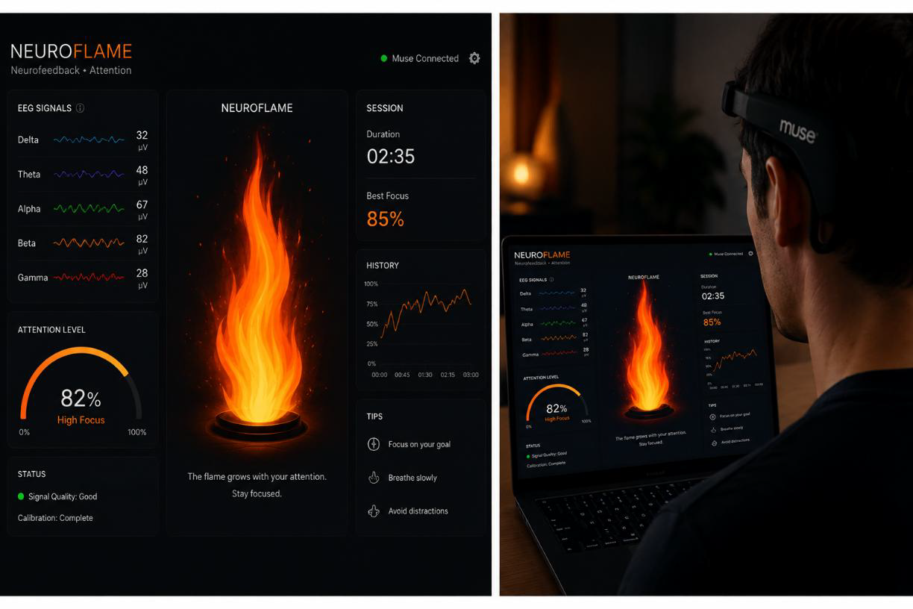
VINCENT PITON · CURRENT RESEARCH
07 / 10
NeuroFlame
2024 · Paris, France · 42 NeurotechX Hackathon — Third Place · Developed in < 3 days
NeuroFlame is an EEG-based neurofeedback experiment developed around sustained attention. Using a Muse EEG headband, the participant's attention was transformed into an immediate visual metaphor a flame that grew as attention increased and changed behaviour when attention was disrupted. Instead of representing EEG activity through graphs or numerical values.
NeuroFlame transformed an invisible cognitive process into something participants could immediately perceive and attempt to influence conceived in relation to attention training and neurofeedback, including possible applications to attention difficulties.
NeuroFlame received Third Place at the hackathon. Although developed in only a few days, it introduced a feedback principle that later became central to Dream Machine.
Brain Activity
→
EEG
→
Flame
→
Perception
→
Attempted Control
→
New Brain Activity

Slide 12
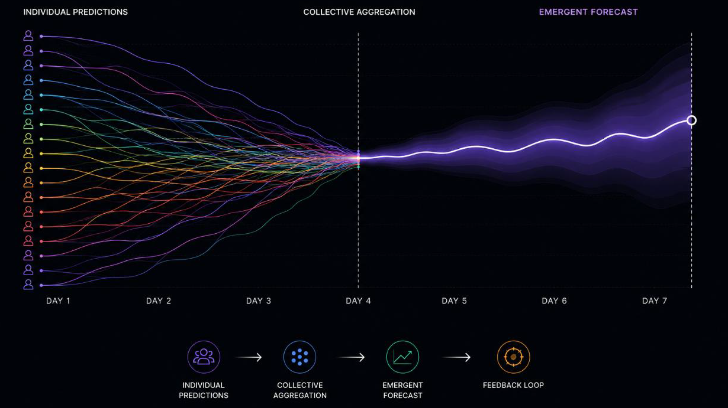
VINCENT PITON · CURRENT RESEARCH
08 / 10
Agora
2024 · Paris, France · Paris Blockchain Week Hackathon · Collective intelligence / blockchain experiment
Agora is an experimental platform exploring collective intelligence, prediction and feedback loops. Participants contribute predictions about the future evolution of financial-market data; rather than treating individual forecasts as isolated opinions, Agora aggregates them into an evolving collective prediction testing whether a sufficiently large collection of individual estimates can produce an emergent signal more accurate than its contributors, a form of crowdsourced anticipation.
But financial systems are themselves influenced by expectations. If enough people see and trust the same prediction, they may begin acting upon it the prediction ceases to be entirely descriptive. It becomes part of the system it attempts to predict.
Agora investigates the unstable boundary between observing a system and participating in its evolution. Where Pivitim explores individual meaning-making, Agora extends this question toward collective interpretation and collective behaviour.
Individual Predictions
→
Collective Aggregation
→
Emergent Forecast
→
Belief
→
Behaviour
→
New Data

Slide 13
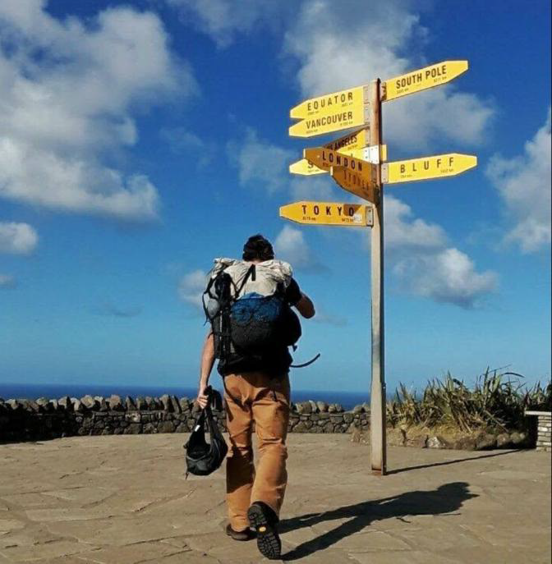
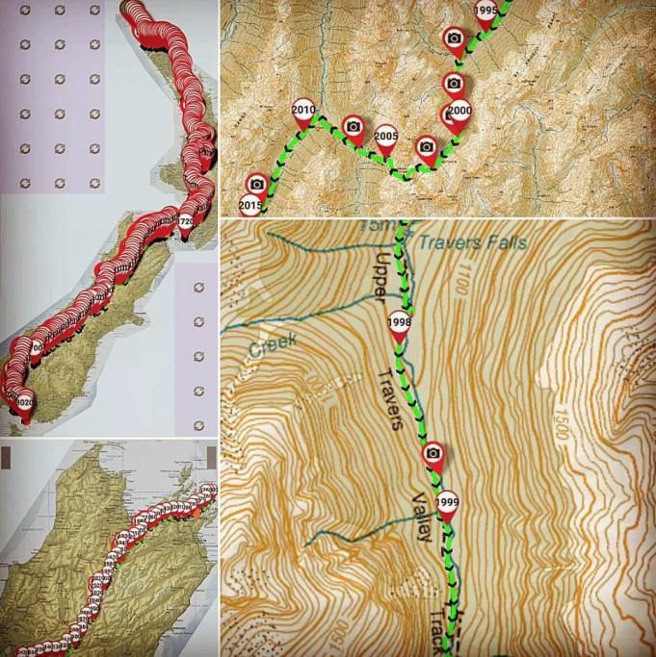
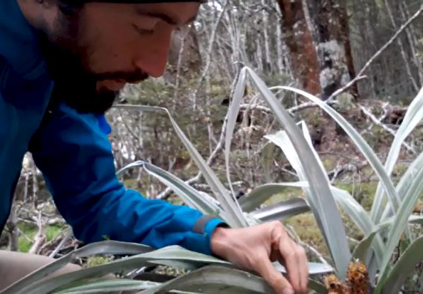
VINCENT PITON · TERRITORY & DATA
09 / 10
Eat the Road
2017–2018
New Zealand
114 days
Approximately 3,000 km
Solo expedition
Eat the Road was a botanical expedition along Te Araroa, crossing New Zealand on foot from north to south. Over 114 days, I walked approximately 3,000 kilometres while documenting wild edible plants encountered along the route.
Before the expedition, I developed a digital field-collection system based on Open Data Kit — botanical observations and GPS coordinates could be recorded in the field and subsequently transformed into a geographic dataset displayed through an online map. Approximately 1,500 botanical observations were documented during the journey.
The project confronted two ways of experiencing the same territory: one physical and subjective — 114 days of walking — the other informational — coordinates, records and points on a map. The resulting database was intended to remain accessible and reusable by future travellers and hikers.
Eat the Road received a grant from the Réunion Island Adventure Film Festival, where I presented the project to an audience of several thousand people; the expedition was documented online and later developed into a documentary teaser.
EAT THE ROAD ESTABLISHED A QUESTION THAT WOULD LATER RETURN IN DRUIDZ AND TATSU
What remains of a place when experience becomes data?

Slide 14
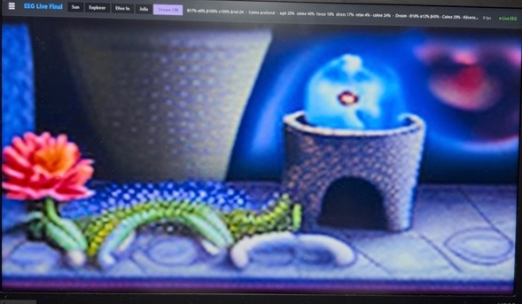
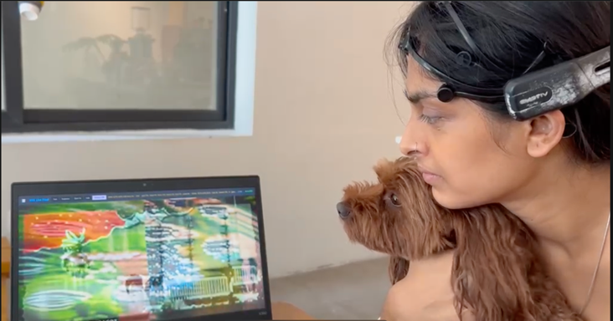
COLLABORATIVE PROJECT · NGOC NAU – VINCENT PITON
10 / 10
Dream Machine
2026
Dream Machine is an ongoing interactive project investigating artificial intelligence, neurotechnology and the trust we place in technological interpretations of ourselves. A participant wears an Emotiv EPOC+ EEG headset; the system works with five major EEG frequency bands: Theta, Alpha, Low Beta, High Beta and Gamma — whose variations become inputs for an AI-driven generative system. The brainwave sensor device produces images from the traces of user’s brain activity in real time.
The project raises disturbing questions, like: ‘Are we looking at the person’s mind or at the imagination of the machine?’
Frames from the generative visual environment, driven in real time by the participant's EEG activity.
User wearing a brainwave sensor device and looking at an image generated from her brainwaves.

